Slide 1
Hebrews 1:1-4
(English Standard Version)
1 Slide

Slide 2
1 Long ago, at many times and in many ways, God spoke to our fathers by the prophets, ² but in these last days he has spoken to us by his Son, whom he appointed the heir of all things, through whom also he created the world. ³ He is the radiance of the glory of God and the exact imprint of his nature, and he upholds the universe by the word of his power. After making purification for sins, he sat down at the right hand of the Majesty on high, ⁴ having become as much superior to angels as the name he has inherited is more excellent than theirs.

Slide 3
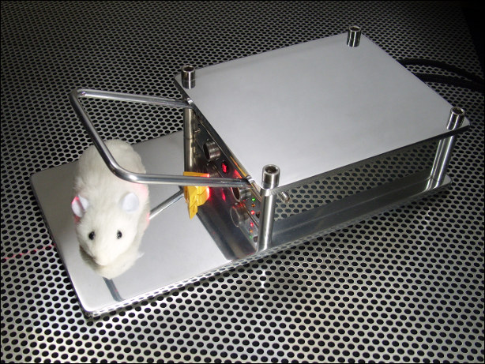

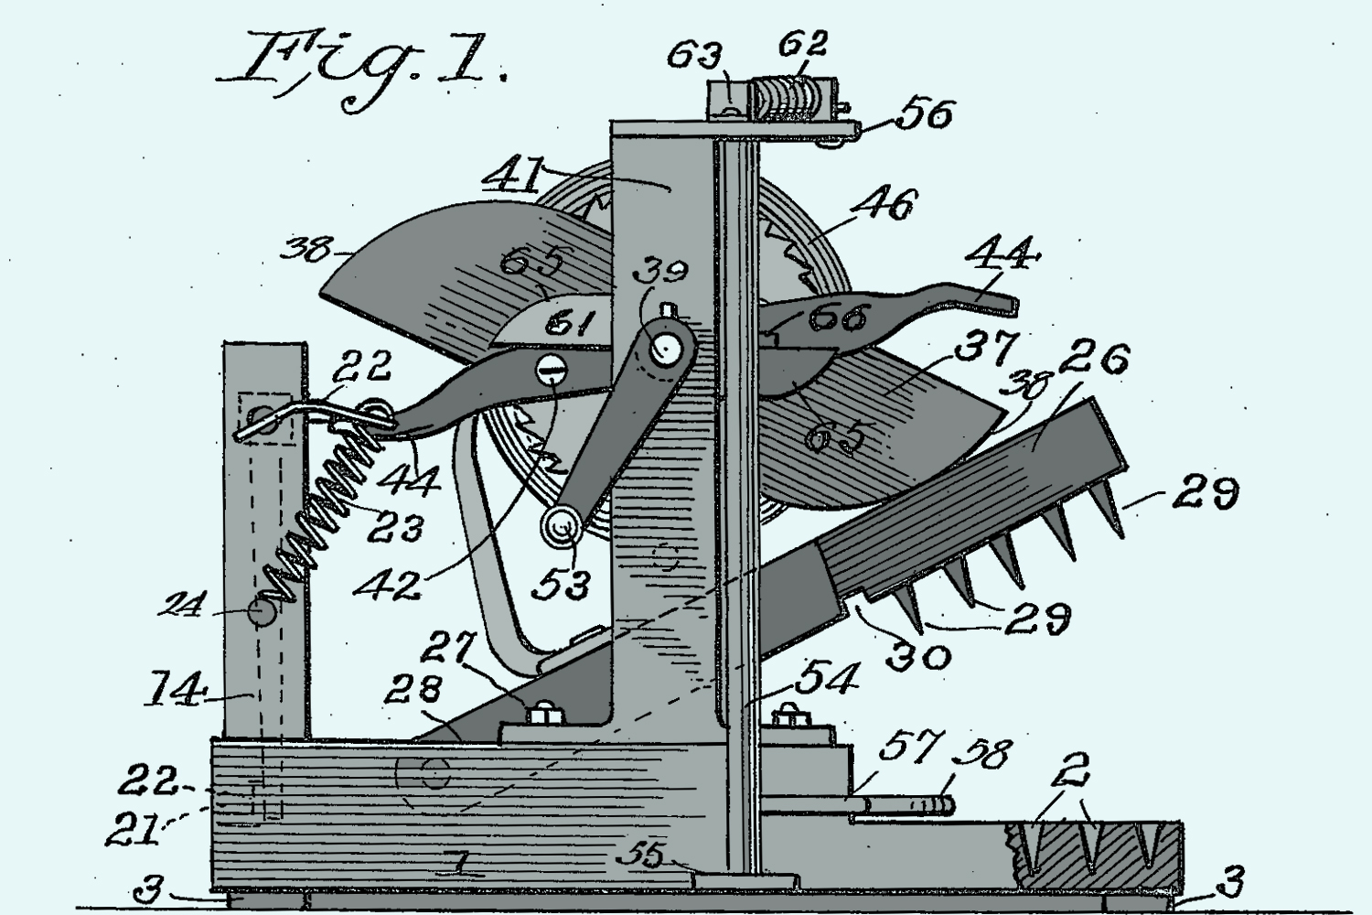
The Quest for a Better Mousetrap

Slide 4
When Faith fades
The human quest to look for something “better”;
Discontent in one’s spiritual experience;
Neglected faith can become a hidden faith / past faith / lost faith.
Hebrews A sermon-letter written to a church who suffered persecution.
A hiding of faith / sliding from faith / counting the cost – “Is it worth it?”
feelings & experiences may draw a person closer to God, But knowing God and knowing the incomparable riches of Christ is what holds us close.
Always a better mousetrap.... But NOTHING is better than Christ Jesus
God speaks through His Son
No other god/religion brings a word of God
Jesus is God the Son
Creation through the Son;
Radiance of the glory of God
Exact imprint of the nature of God
Upholds universe by the word of power
Jesus purified us of our sins
No other god/religion can purify one from sin.
Sits at God’s right hand.
Far superior to any angel.
Engaging with a God who speaks to us today
When Jesus speaks, He reveals the very nature of God.
When God speaks through His word it cuts deep. (A life-changing word)

